Slide 1
A machine learning model for the ncaa men’s basketball tournament
Ethan marks
Python for Data Science, CSCI E-29
Harvard University

Slide 2

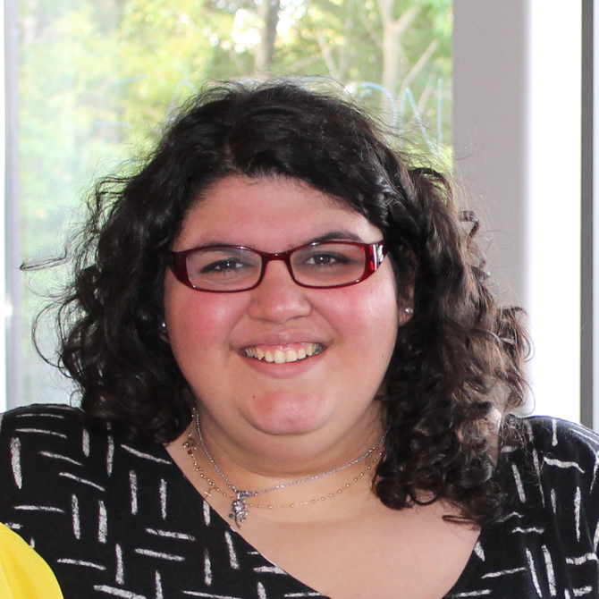

CSCI E-29 2018 Staff
Nenad Svrzikapa
Instructor
Lena Hajjar
Teaching Fellow
Philip Lodine
Teaching Fellow
Kaleigh Douglas
Teaching Fellow
Alan Xie
Teaching Fellow
Joe Palin
Teaching Fellow

Slide 3
Abstract
Max = [10] based on your project select one
I built a model that can predict whether a men’s college basketball team will beat the Vegas spread in its first game of the NCAA tournament
My model has greater than 50% accuracy
Surprisingly, one of the features with the most predictive value is the experience level of the underdog

Slide 4
Required Libraries and files
PANDAS
conda install -c anaconda pandas=0.19.2
NUMPY
conda install -c anaconda numpy
DATASET LOCATION
https://github.com/ethanwmarks/CSCIE-29
URL FOR DOWNLOADING YOUR NOTEBOOK
https://github.com/ethanwmarks/CSCIE-29

Slide 5
REFERENCES
I used the following resources for data or coding hints:
Data from KenPom.com
Class notes and prior completed problem sets
https://stackoverflow.com/questions/32902837/replace-substring-in-pandas-data-frame-column?utm_medium=organic&utm_source=google_rich_qa&utm_campaign=google_rich_qa
https://stackoverflow.com/questions/14247586/python-pandas-how-to-select-rows-with-one-or-more-nulls-from-a-dataframe-without?utm_medium=organic&utm_source=google_rich_qa&utm_campaign=google_rich_qa

